Slide 1
Interpolation methods for 3D geological modelling
Lachlan Grose, Laurent Ailleres, Gautier Laurent, Fernanda Alvarado.

Slide 2
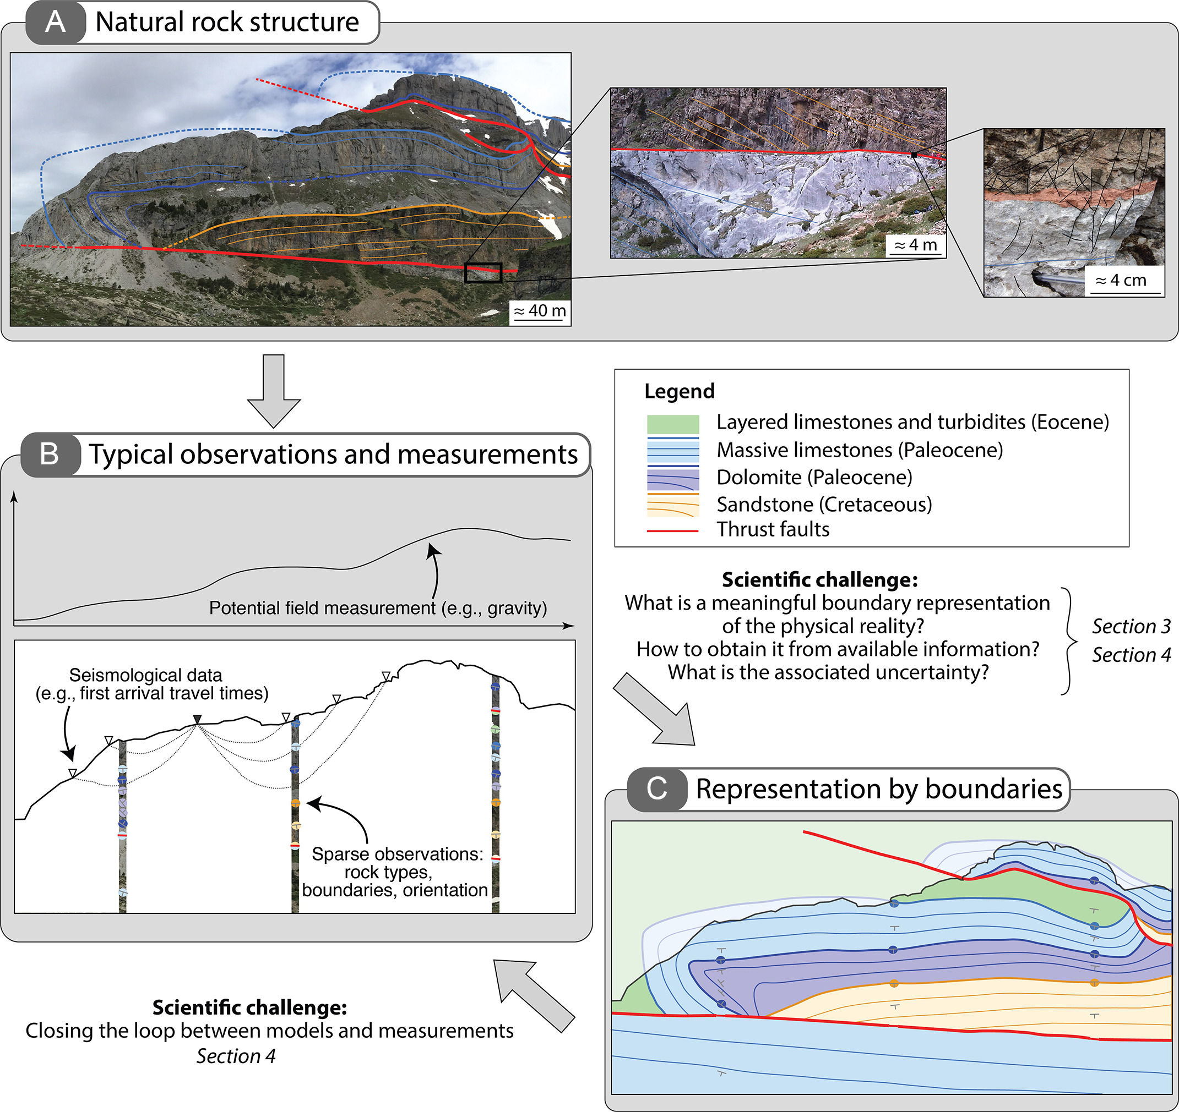
What is a geological model
Numerical representation of the geometry and distribution of geological objects
Topology of geological objects
Geological units
Boundary representation (surfaces)
Volumetric representation
Discontinuities
Representation of geometry (surface)
Effect on other features
Faults
Unconformities
Wellmann and Caumon 2018

Slide 3
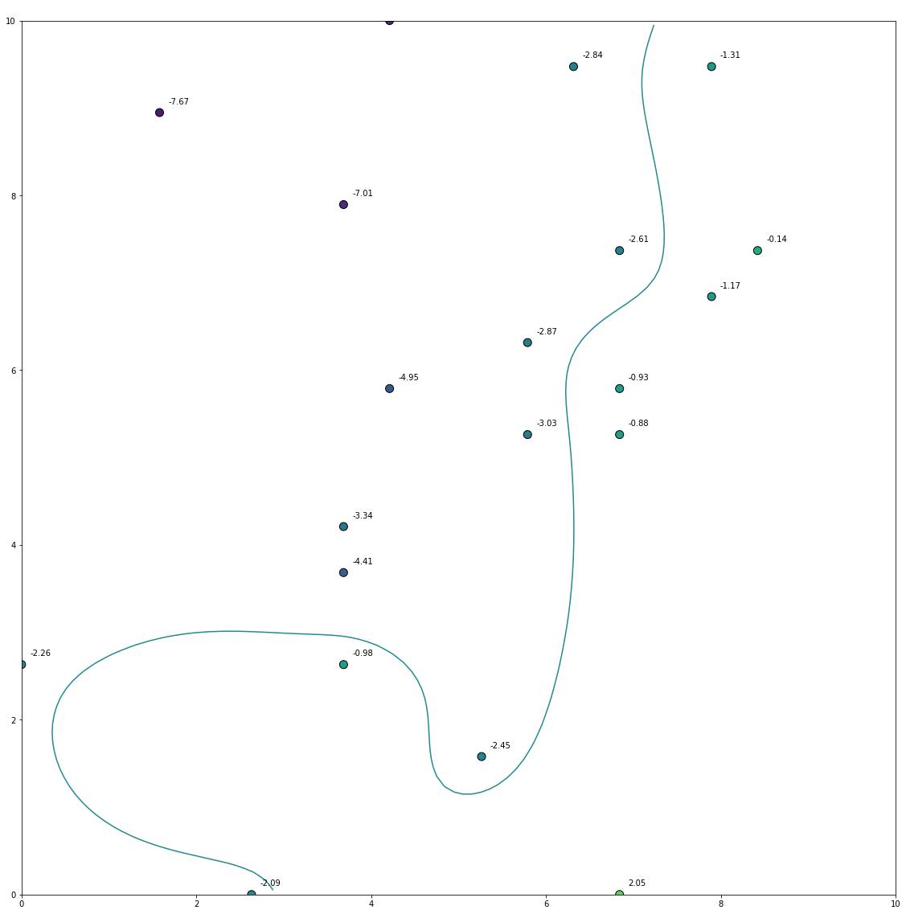
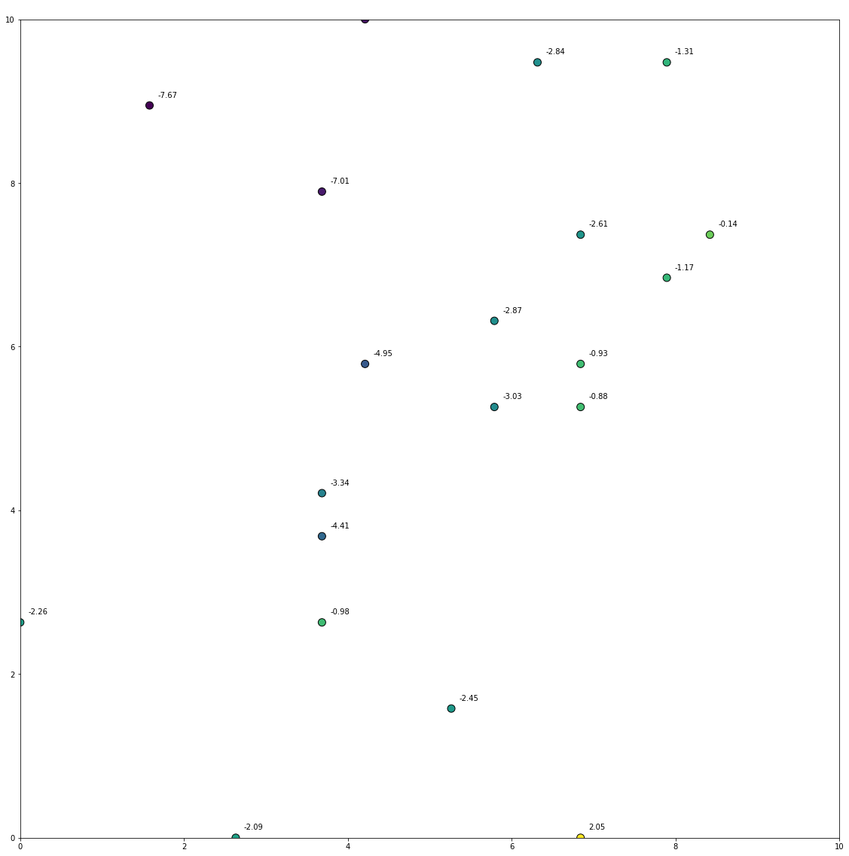
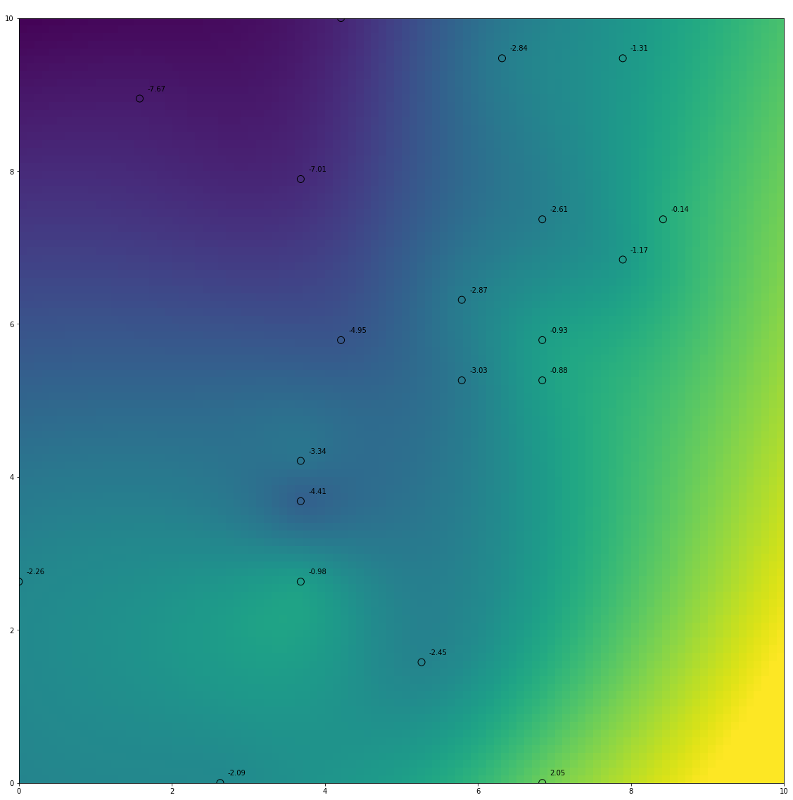
How to build surfaces?
2D equivalent is contouring value data
- manually contour
- interpolate value onto grida
- contour using marching squares

Slide 4
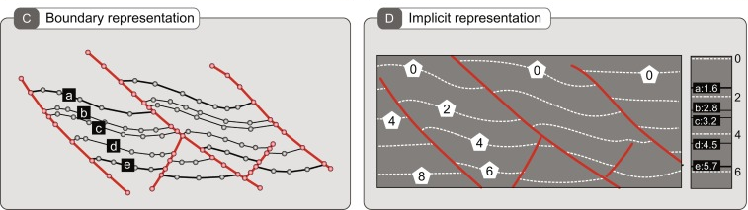
Methods for representing geology
Explicit representation
Implicit representation
19 surfaces
6 Implicit functions
Wellmann and Caumon 2018
Explicit | Implicit
Surface geometry collocated with the representation of the surface | Surface is extracted from an isovalue of an implicit function
Topology is defined by the geometry of the surfaces | Implicit function approximated from observations
Update of surface geometry is difficult | Each feature is represented by a different function, multiple surfaces → same function
Surface geometry is controlled by geologists knowledge | Quick to update and reproducible
Subjective and time consuming | Knowledge is difficult to incorporate
One support per surface | Topology defined by order of Boolean operations

Slide 5
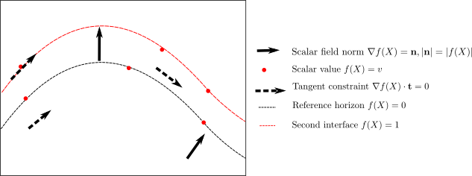
Implicit modelling constraints
f(X) – f’(X) = 0
Gradient normal constraints
Gradient tangent constraints
Interface value constraint
Scalar value constraint
f(X) – f’(X) = 0

Slide 6
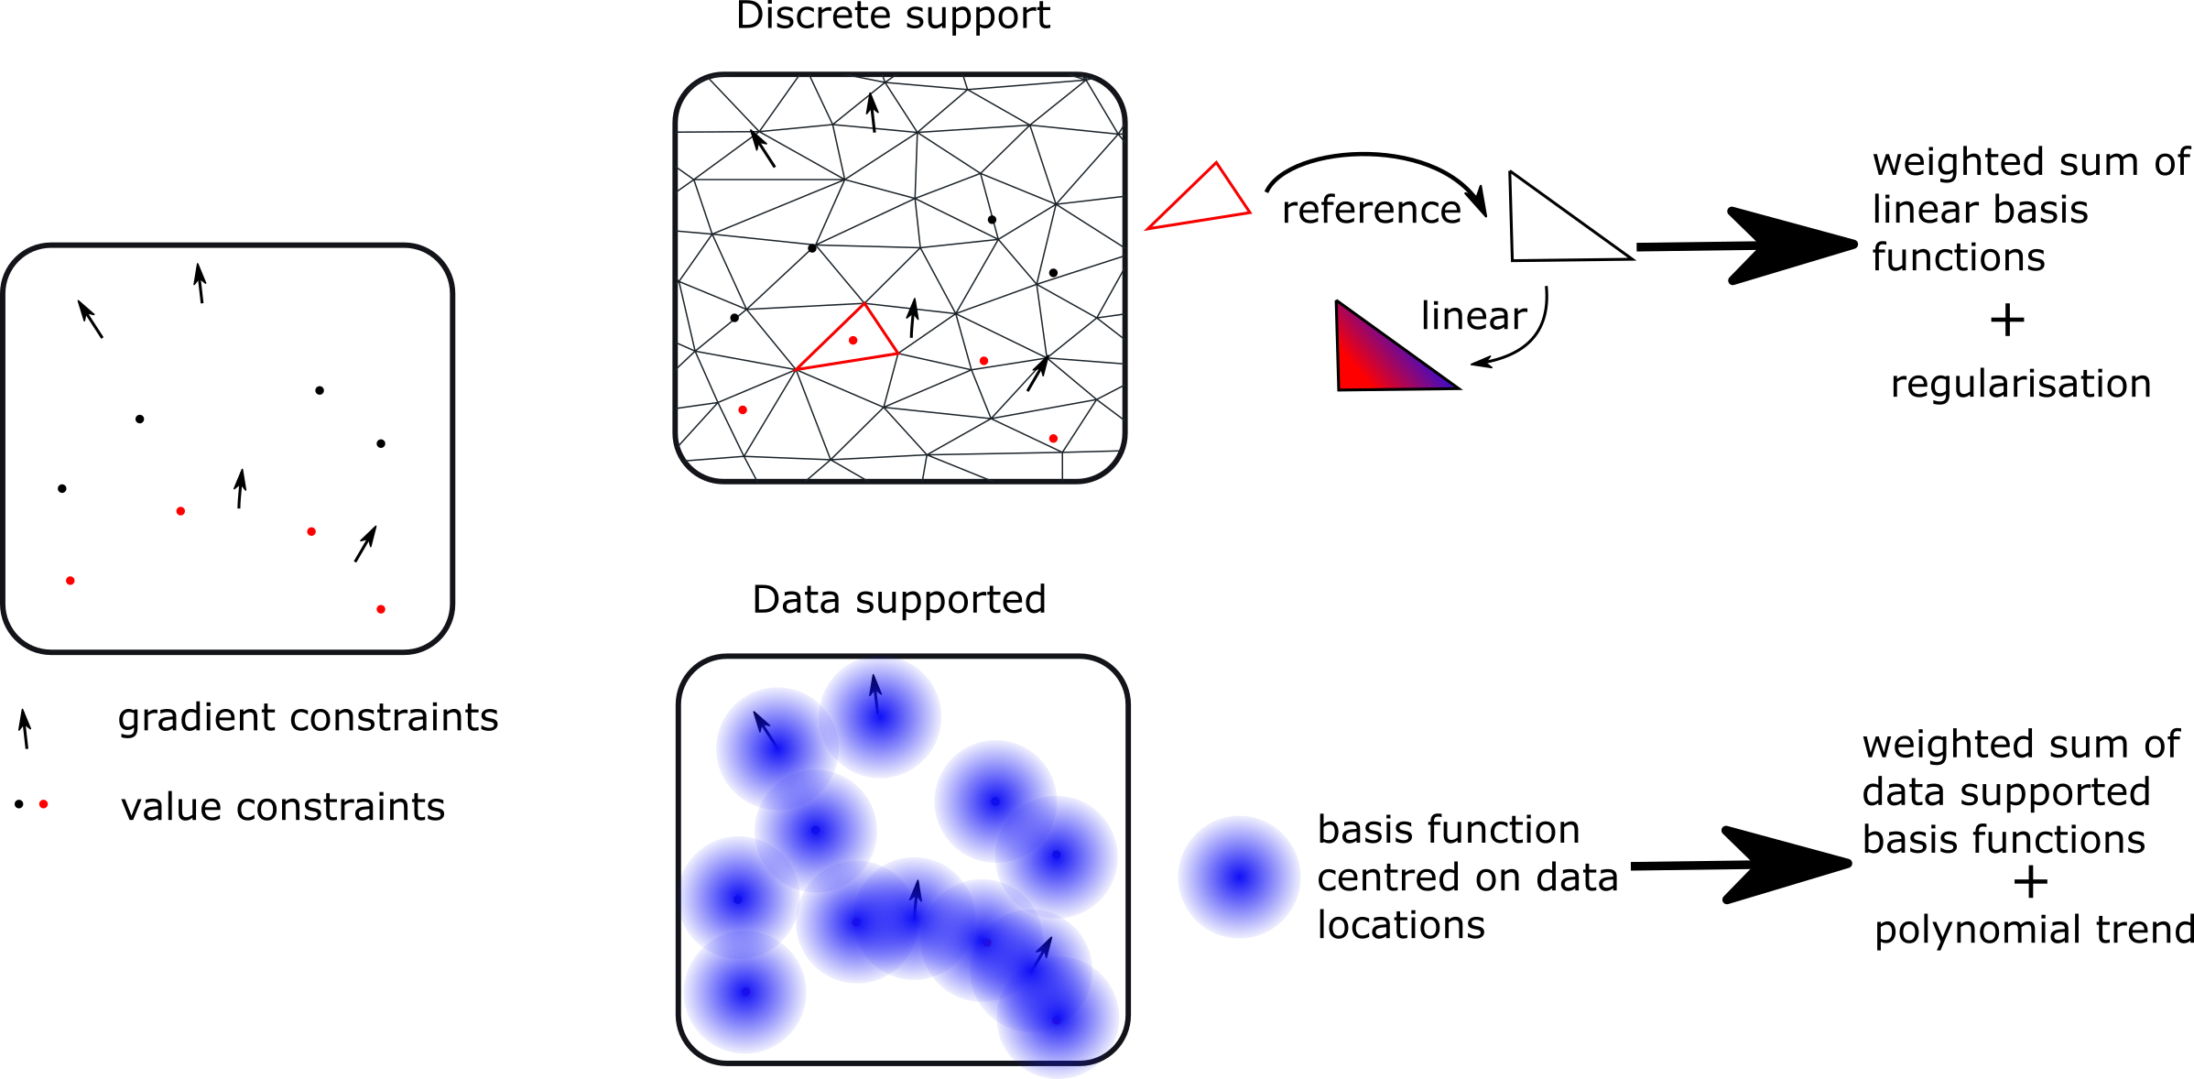
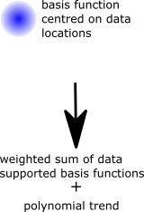
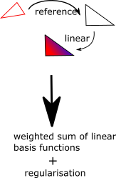
How implicit modelling works
Least squares minimisation
Balance regularisation and observation constraints
Solve linear system of equations
Exact fit of function and observations

Slide 7
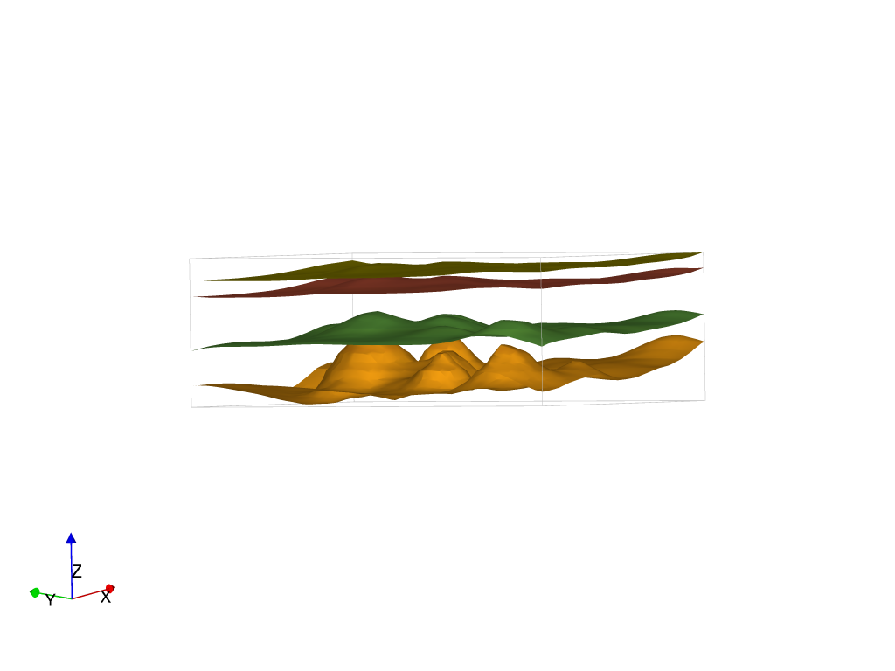
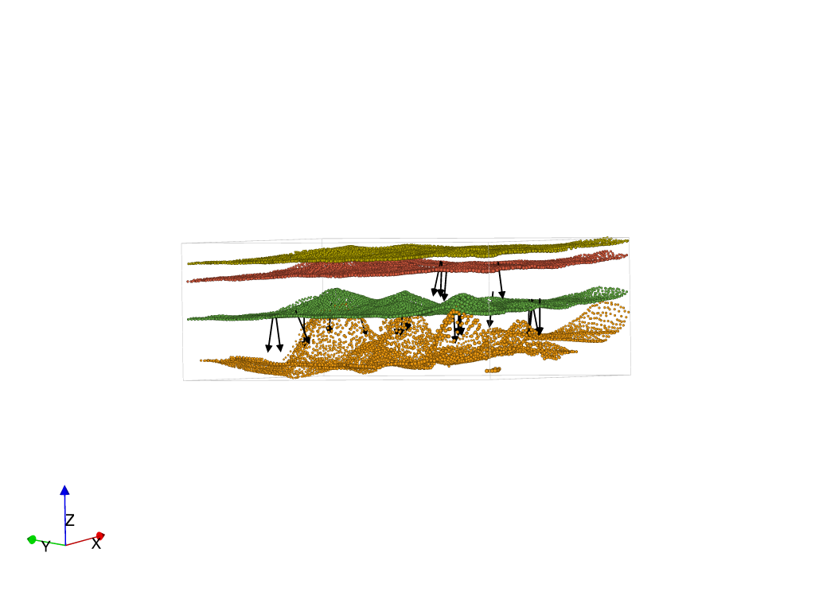
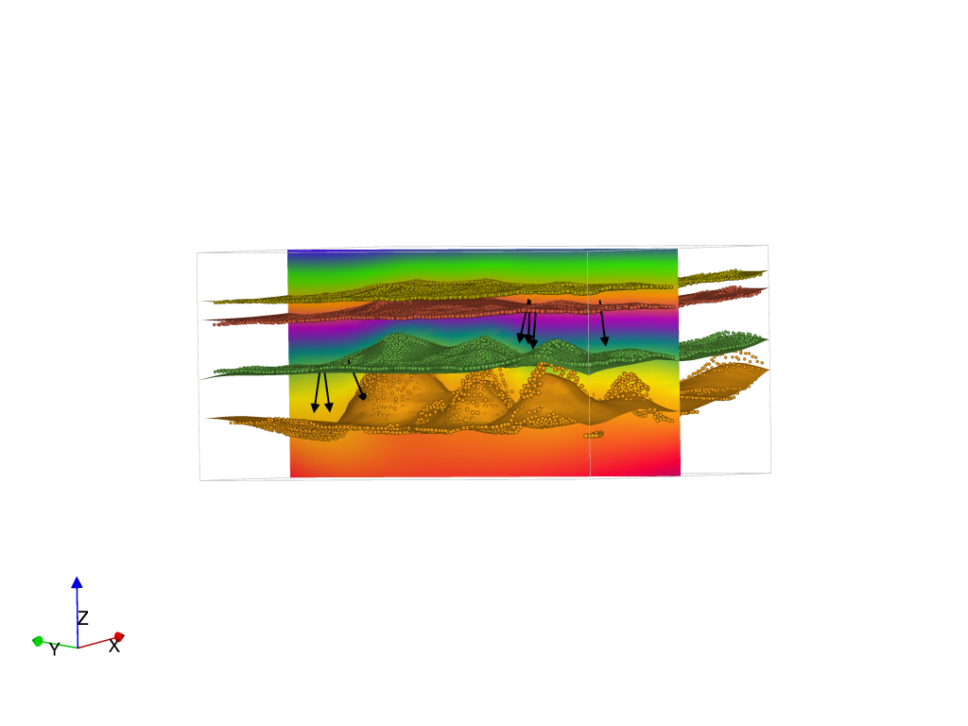
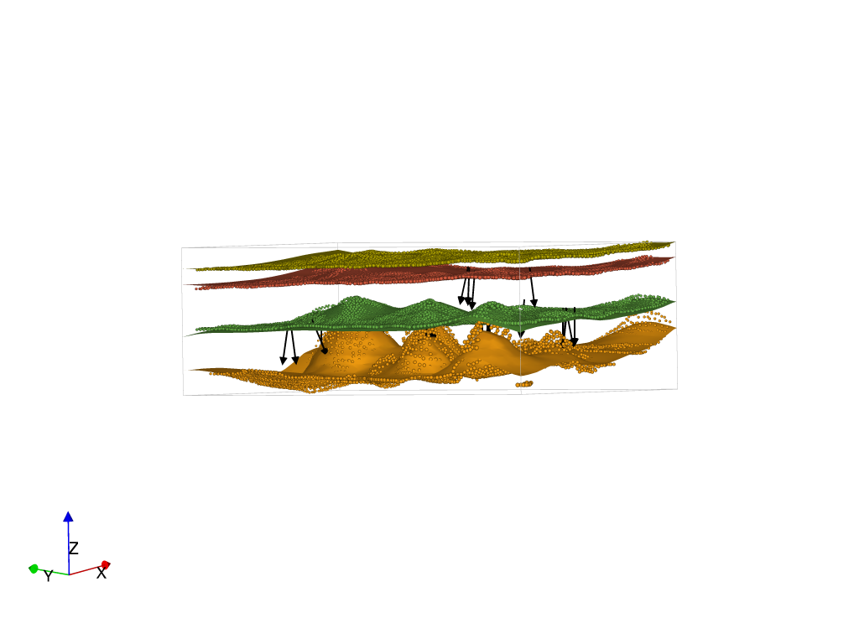
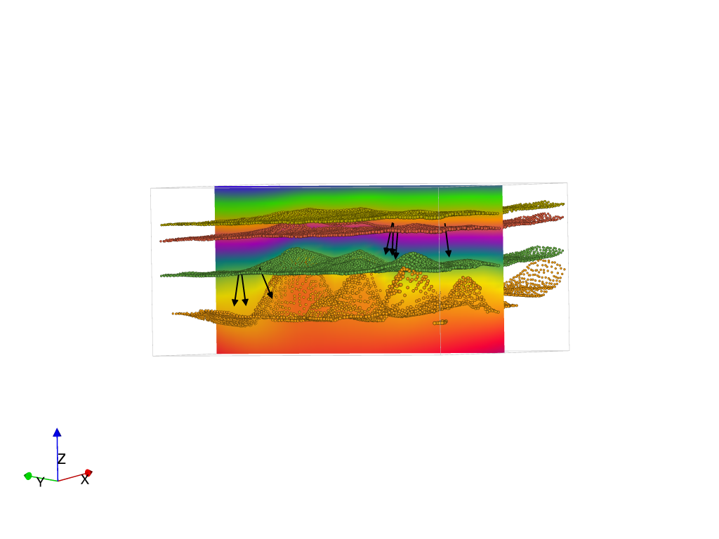
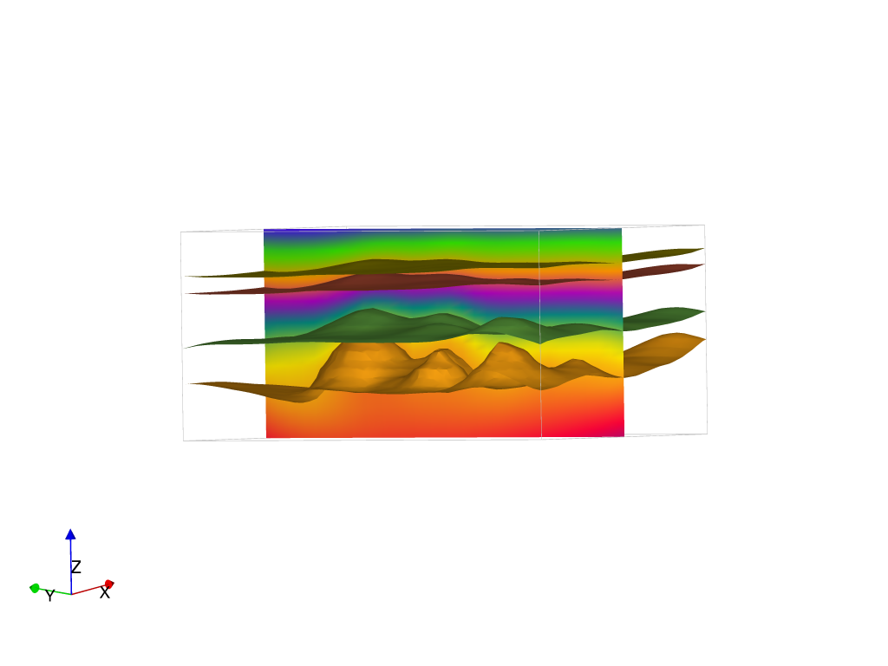
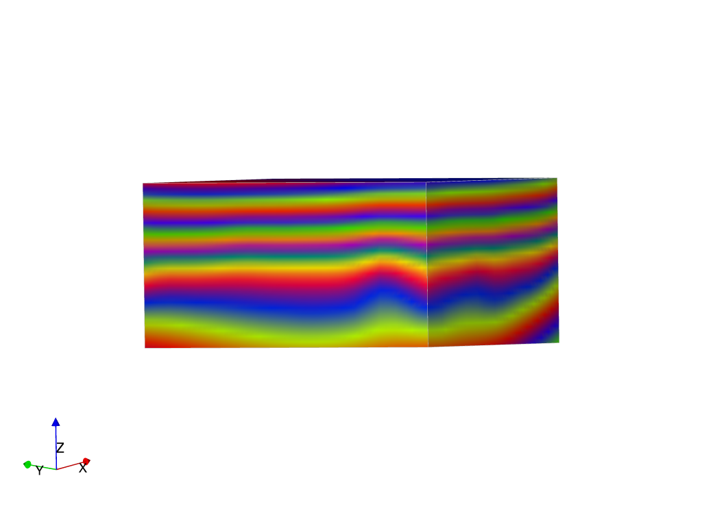
Implicit surface modelling
Approximate implicit function from geological observations (contacts, strike and dip) using weighted combination of basis functions
Data supported
Discrete approach
Implicit function can be evaluated anywhere in the model volume defining stratigraphic thicknesses
Surfaces are extracted by tracing isovalues (3D contours) of the implicit function
Calgagno et al., 2008; Chiles et al., 2004; Cowan et al., 2003; Frank et, al., 2007; Hillier et al., 2014; La-junie et al., 1997; Mallet 1992,14

Slide 8
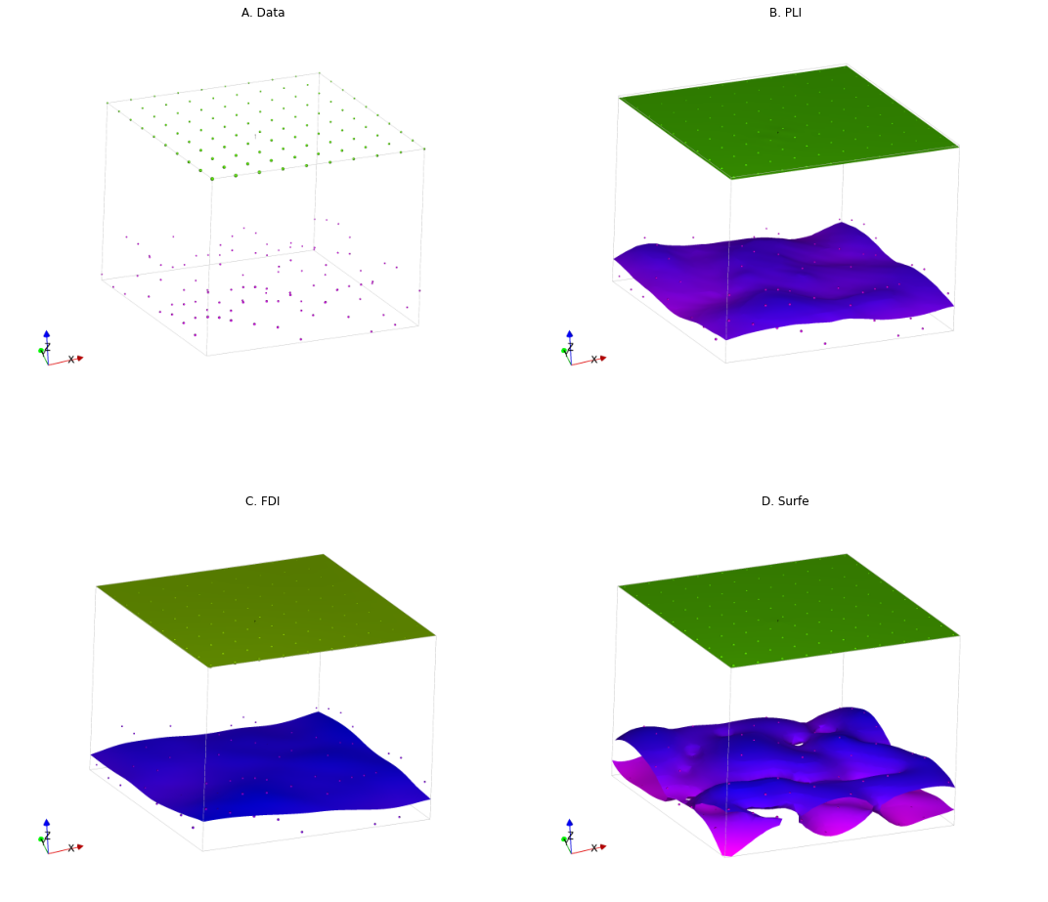
A case study
Surface locations sampled from flat plane
Surface locations sampled from a flat plane with noise added

Slide 9
Comparing interpolators
Discrete:
Piecewise Linear interpolator
Discrete:
Finite difference interpolator
Data supported:
Surfe Radial Basis Interpolation
Single isosurface has topology suggesting multiple surfaces

Slide 10
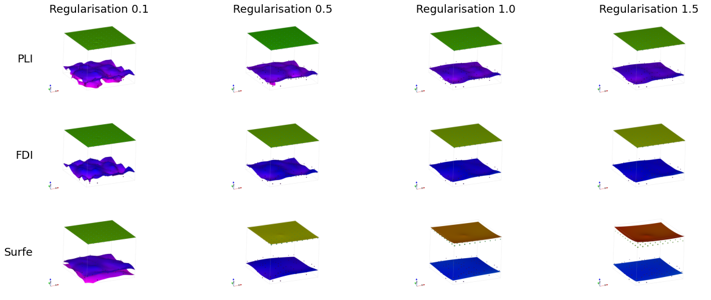
Adding smoothing to RBF
Shift location of smooth surface
Increasing smoothing
Topology of surface is better

Slide 11
Varying regularisation
Low regularisation fits data points better
Increasing smoothing

Slide 12
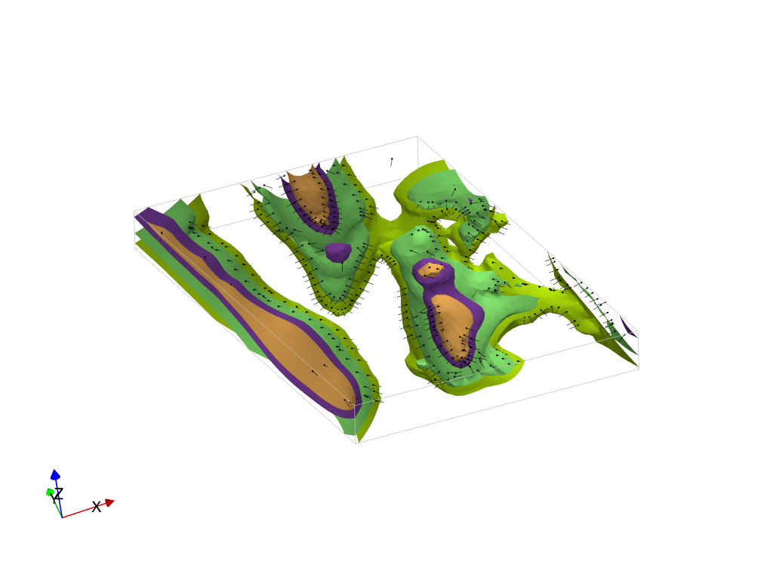
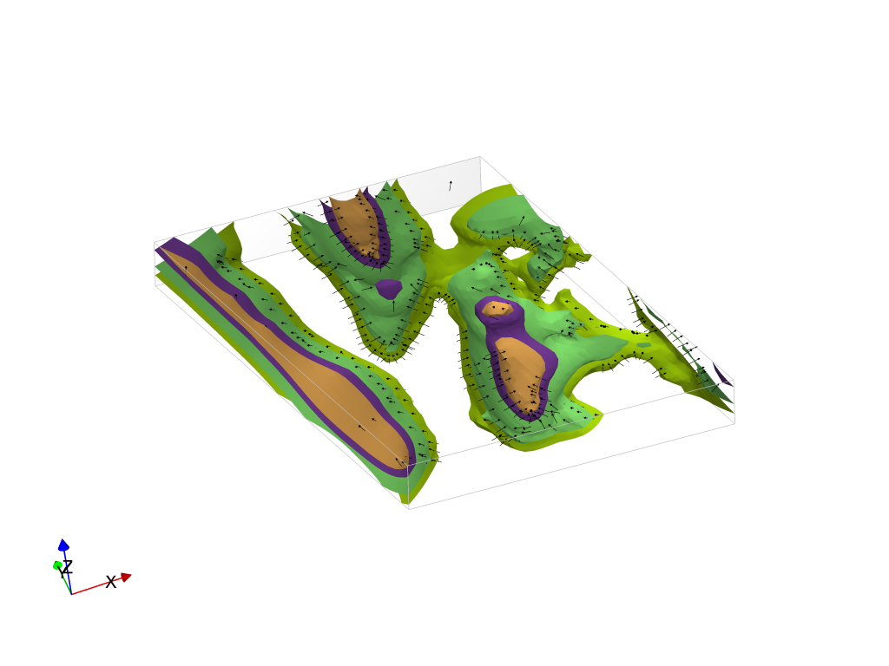
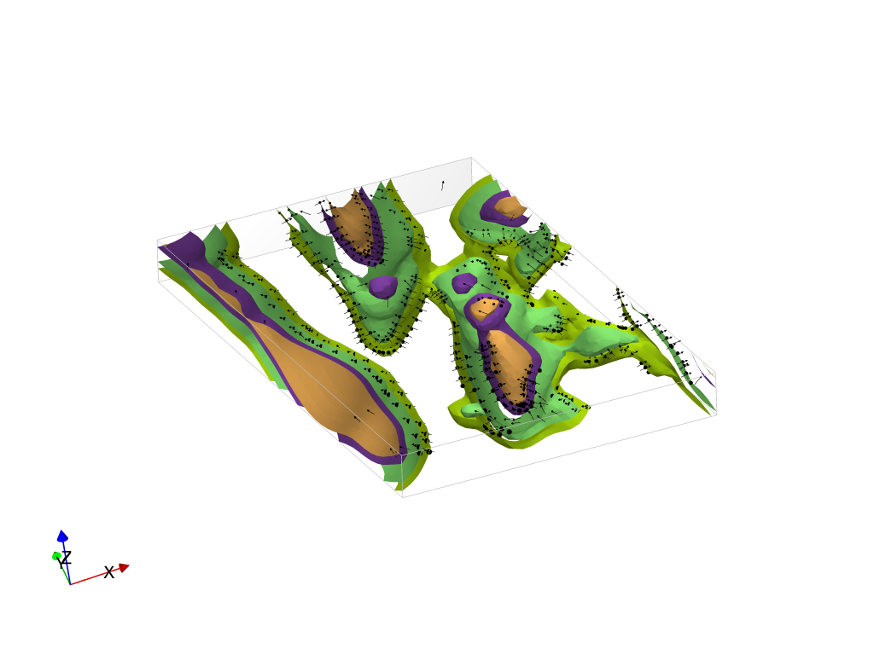
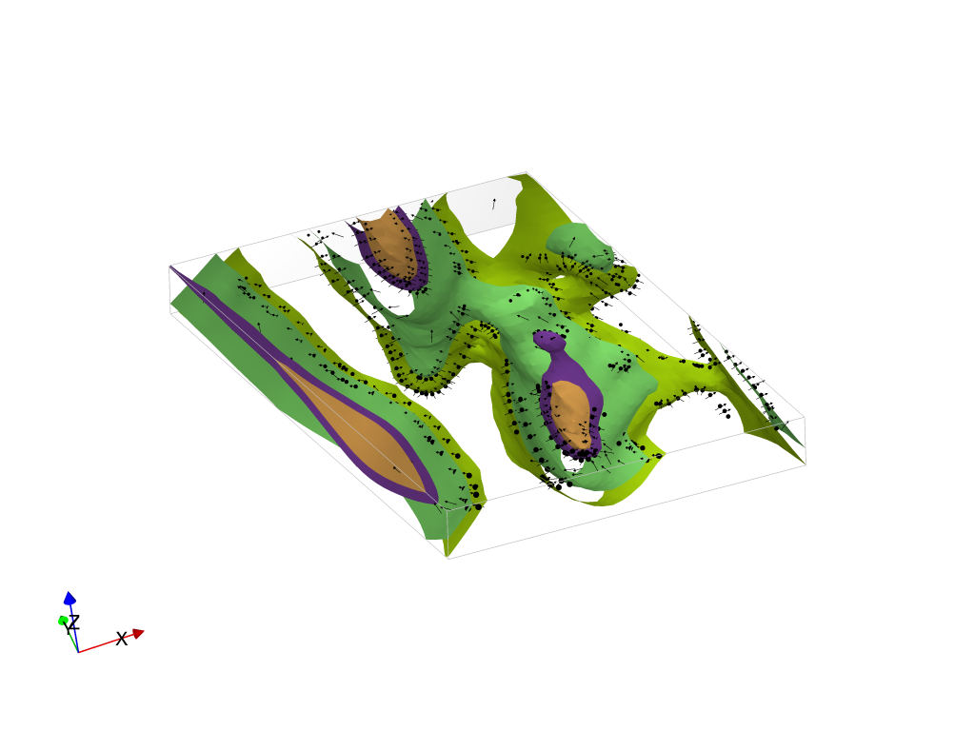
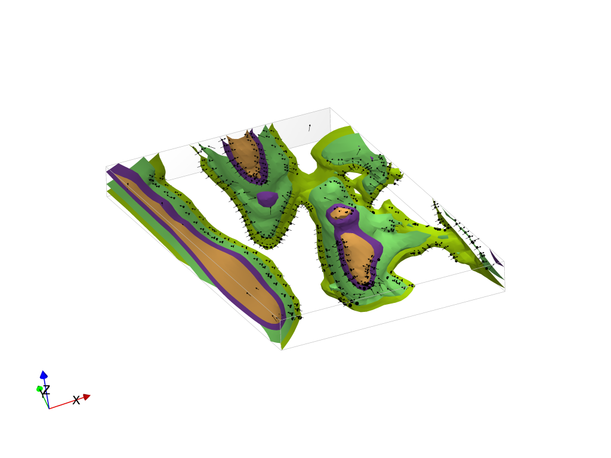

Comparing interpolators
Piecewise Linear Interpolator: Value constraints
Finite Difference Interpolator: Interface constraints
Radial Basis function Interpolator: Interface constraints

Slide 13
Understanding the differences
Outcrop | RBF interface | PLI value | FDI interface
 | Circular blob, resulting from flipped polarity vectors | Smooth fold limb | Small artefact but smoothed
 | Fold hinge with outcropping purple blob | Fold hinge | Fold hinge with outcropping purple blob
 | Circular feature outcropping orange and purple | Antiform hinge with green surfaces | Circular feature with green surfaces
 | Basin | Saddle | Saddle with part of basin
 | Slightly folded limb | Smooth fold limb | Slightly folded limb

Slide 14
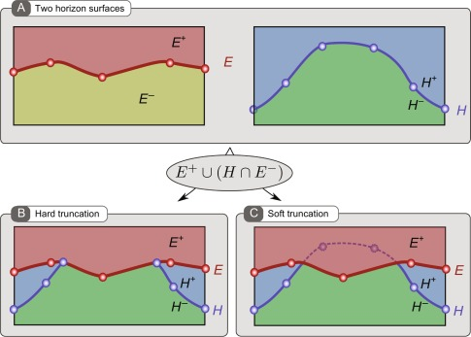
Adding unconformities

Slide 15
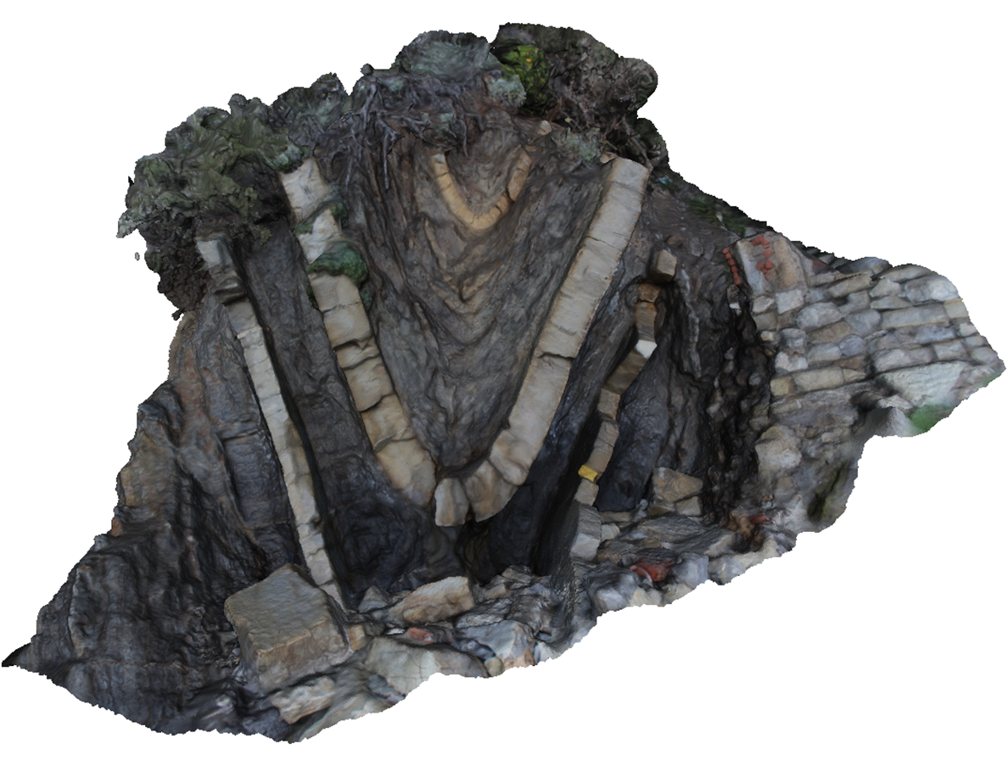
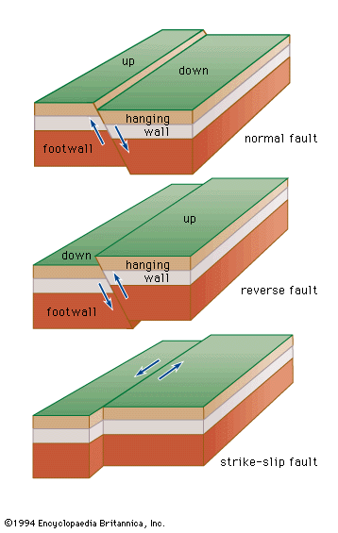
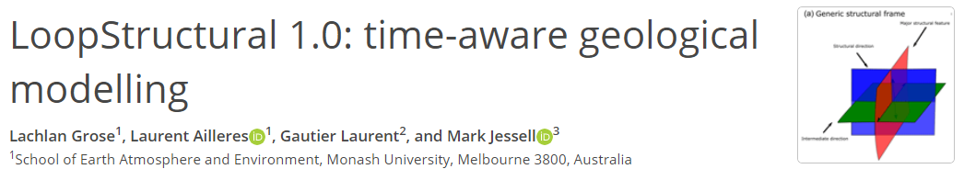
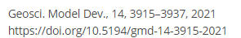
The Structural Frame concept
Three coordinates – three scalar fields
Major structural feature
fault surface
fold axial surface
intrusion major axis
Structural direction
fault slip direction
fold axis
intrusion flow direction
Additional direction (if required)
Fault , e.g. fault extent

Slide 16
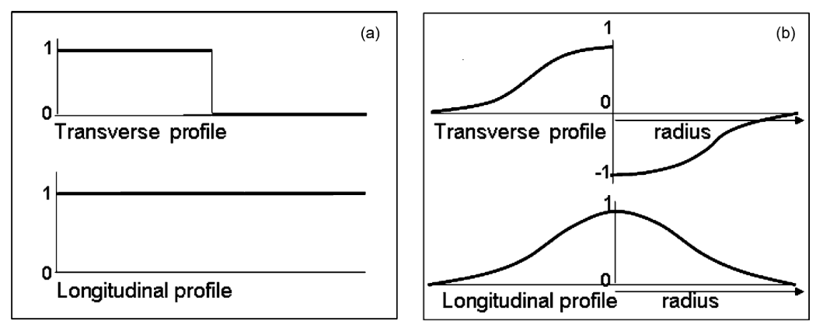
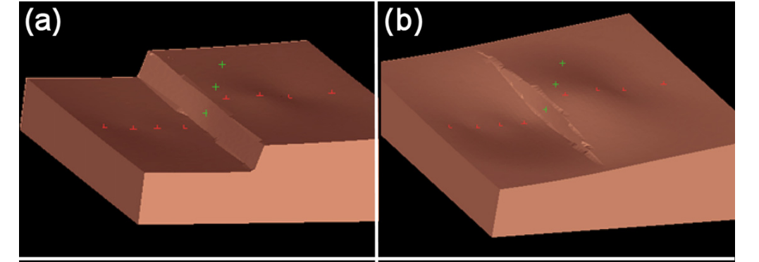
Faults using step functions
Calcagno et al 2008

Slide 17
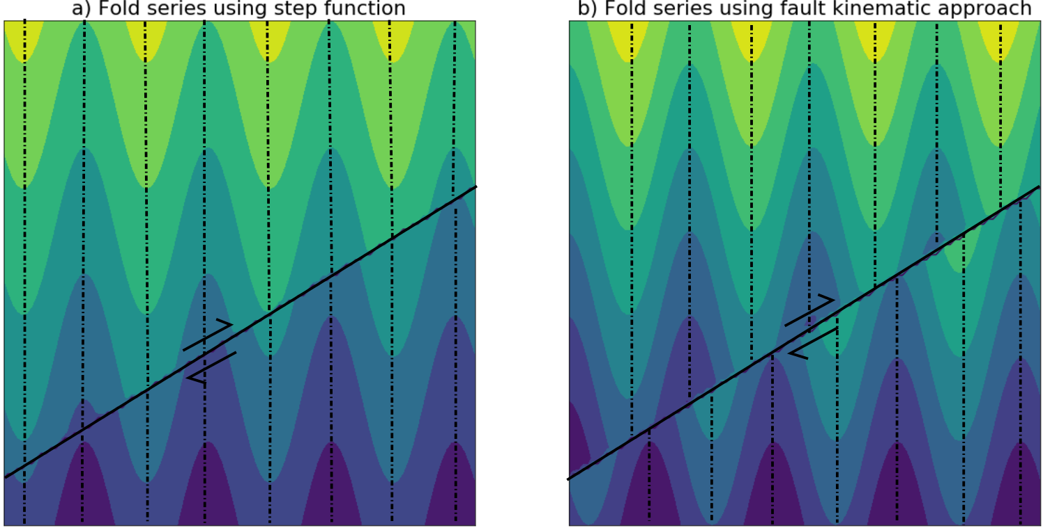
Problem with step functions
True fault kinematics
Step function
Fold hinges are not faulted… only scalar field value changed!
Pure dextral strike slip fault in map view

Slide 18
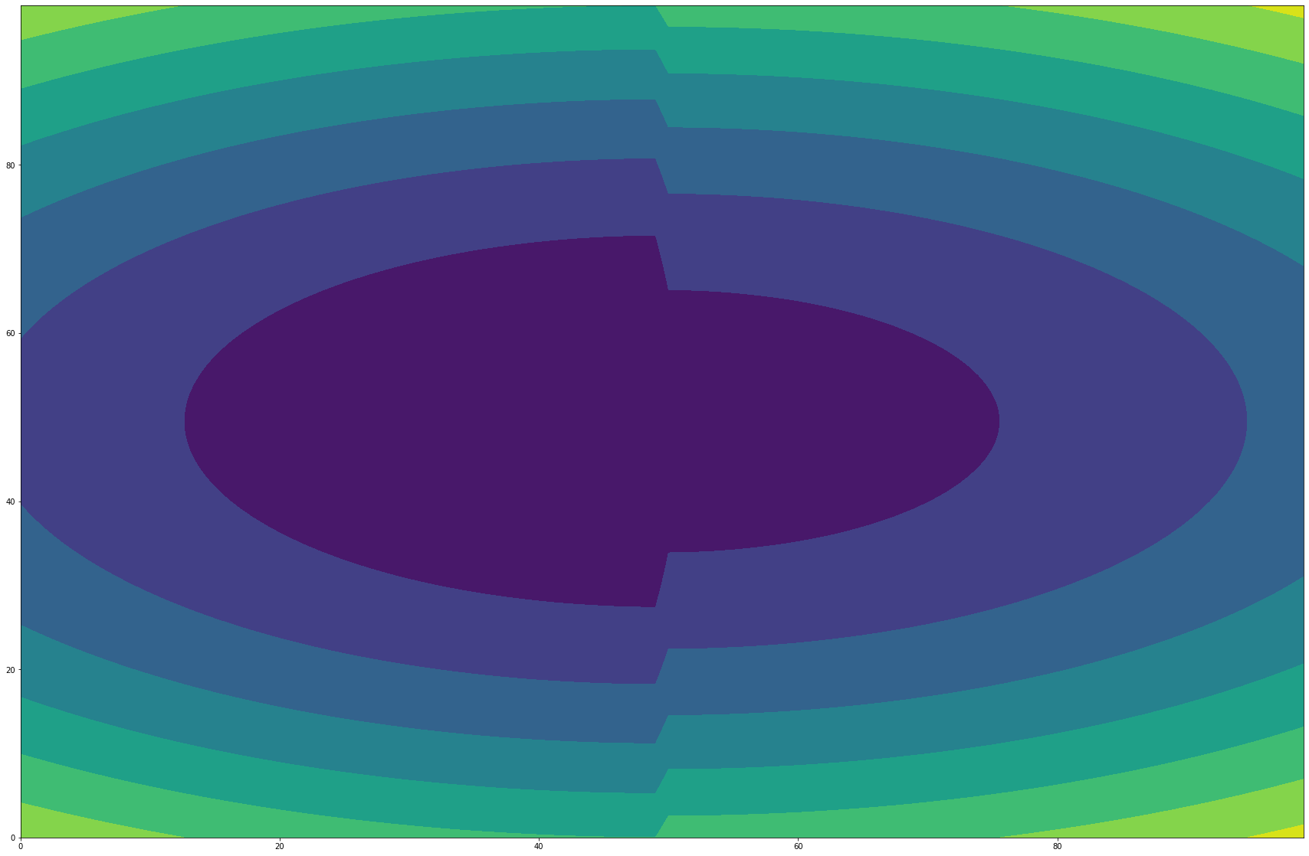
Shrinking intrusions?
Map view of an implicit function of a pure strike slip faulted scalar field using step functions

Slide 19
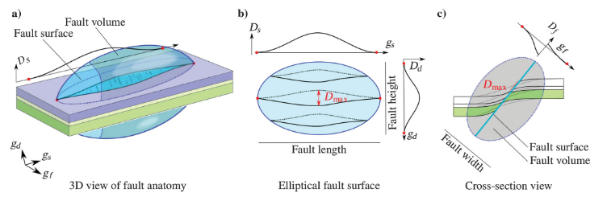
Apply fault to an existing surface
Godefroy et al 2018

Slide 20
Problems
Fault splays?
Folded stratigraphy?
Intrusions?

Slide 21
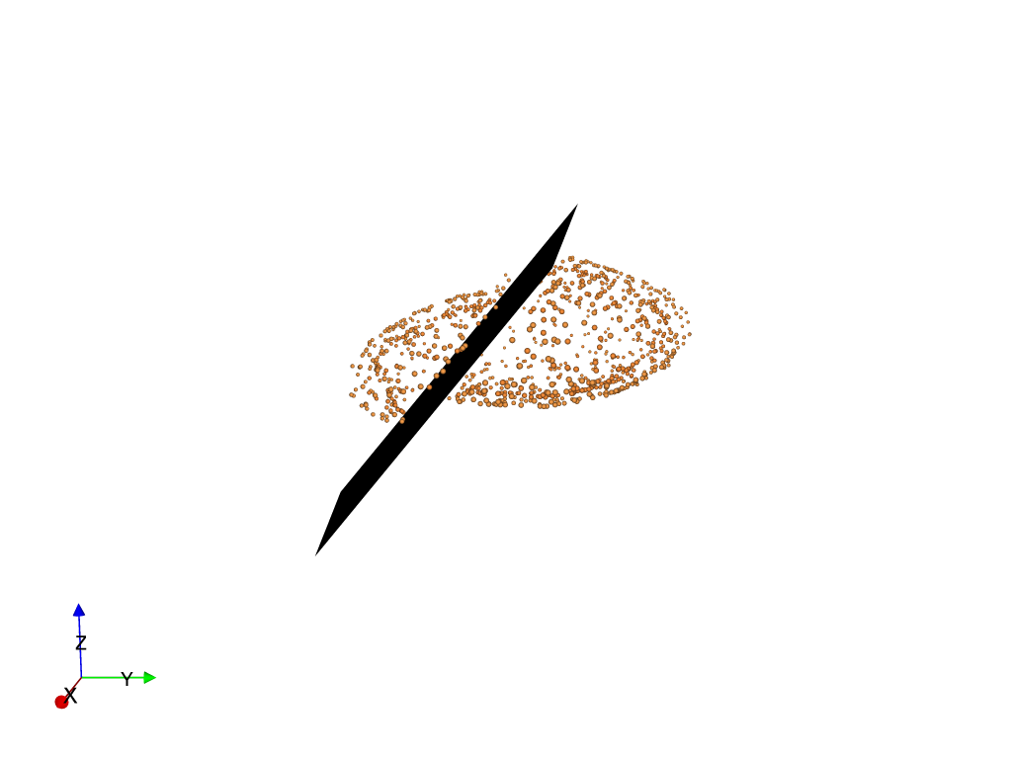
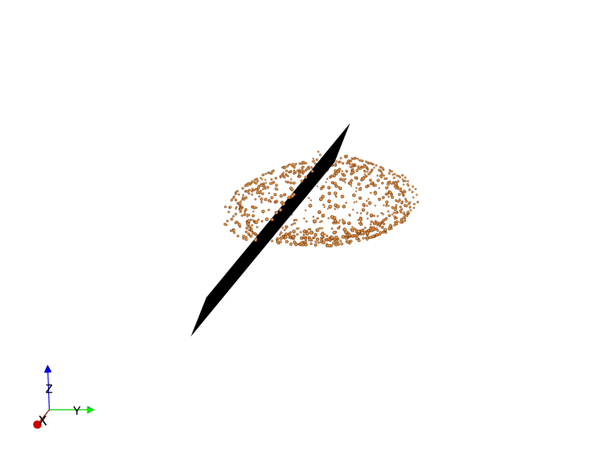
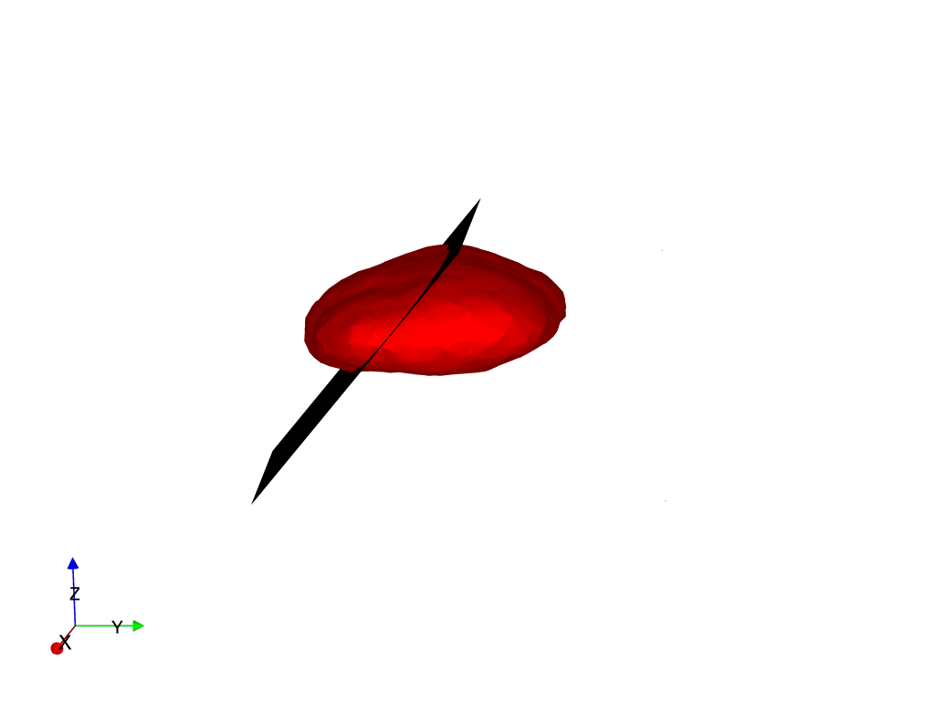
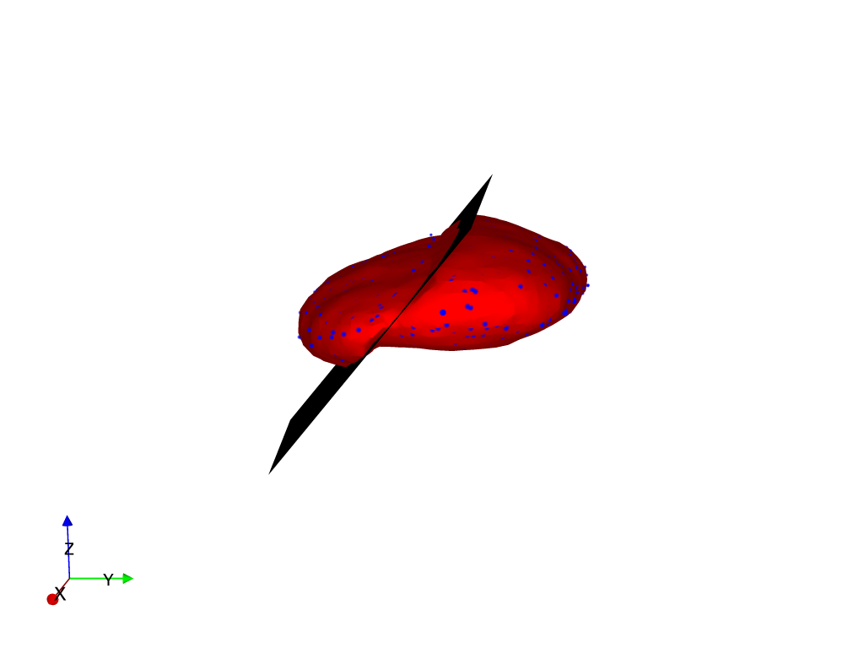
Direct kinematic integration

Slide 22
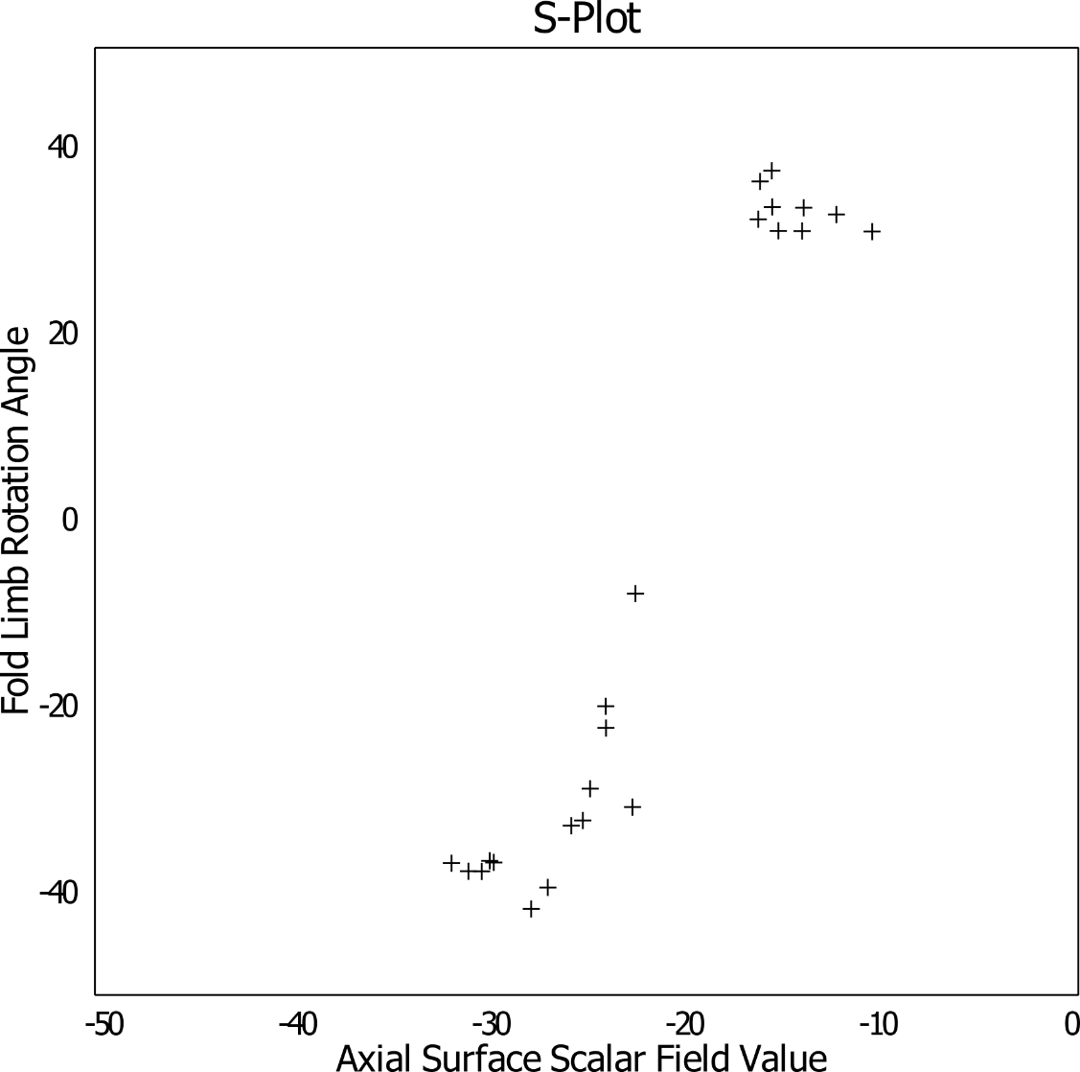

Fold structural frame
Point of inflection?
Hinge
Limb
Point of inflection?
½ Wavelength

Slide 23
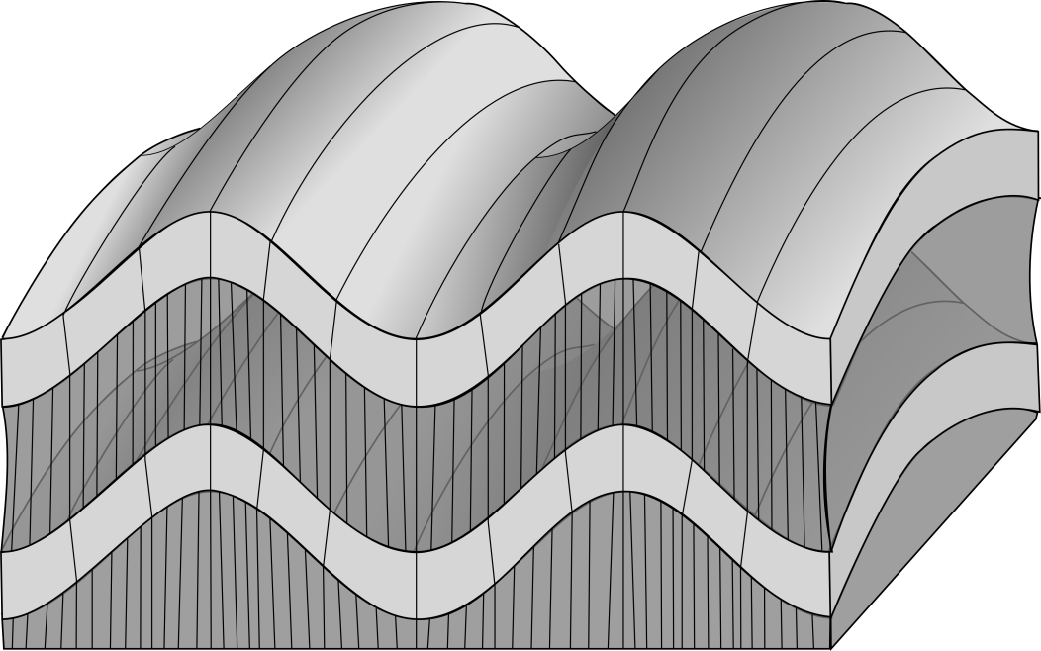
Implicit Fold Modeling: fold frame
Fold Frame F = (X,Y,Z)
Based on the finite strain ellipsoid
Relative orientation of deformed foliation.
Local rotation within the fold frame.
Fold axis rotation angle (α_{p})
Fold limb rotation angle (α_{L})
X
α_{p}
α_{L}
S_{i-1}
Z
α_{L}
Y
α_{p}
Laurent et al., 2016, EPSL

Slide 24
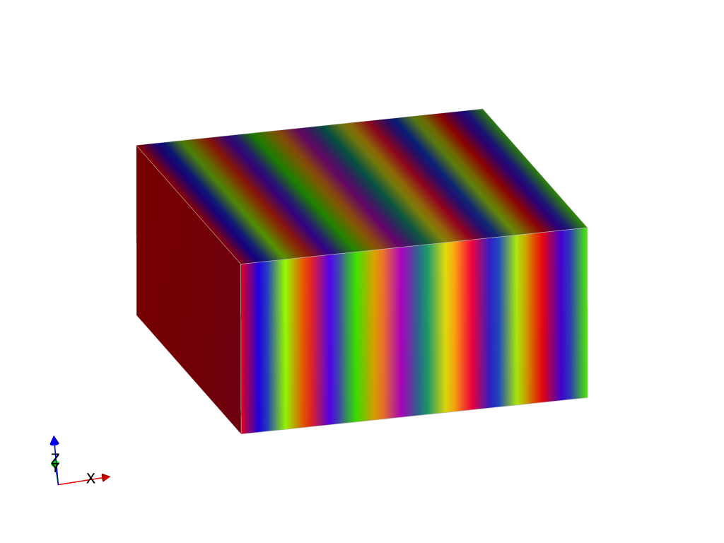
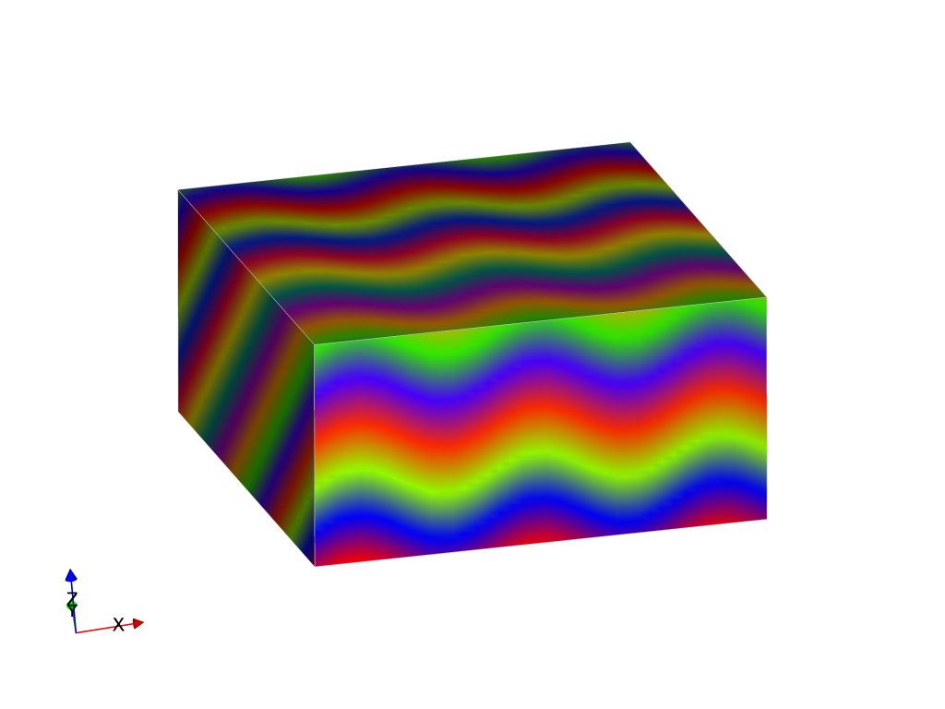
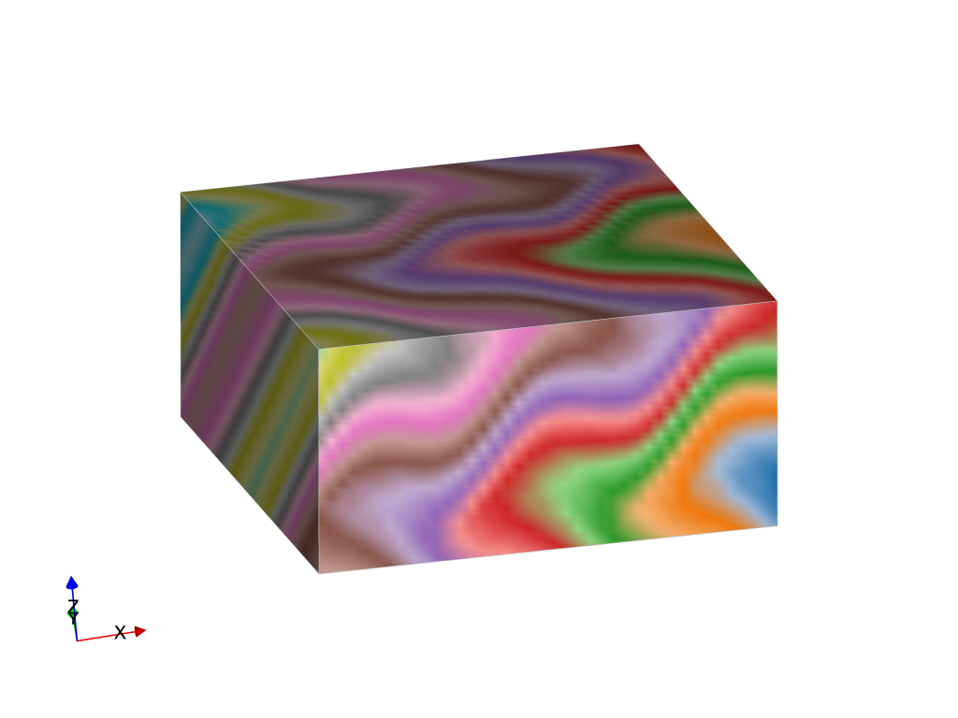
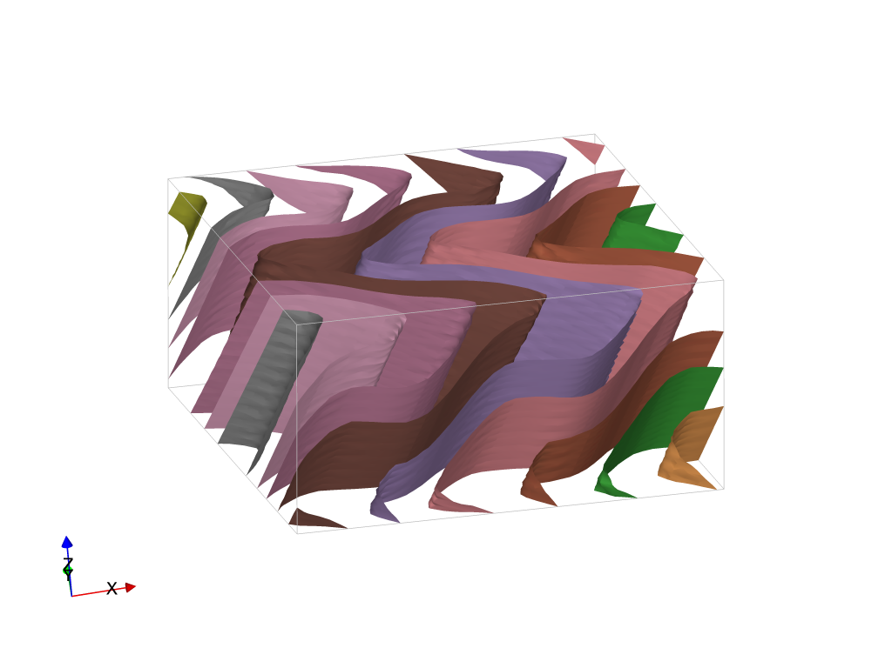
Time-aware Geometrical modelling – combining structural frames
S2⁺
S2
S1⁺
Poly-deformation:
Modelling events step by step
Time-aware process: youngest event is modelled first, then the second youngest, etc… until the primary foliation (most often bedding) is modelled
Modelling is geometry based (not mechanical)
Event types:
each fault or family of faults
Folding event
Unconformity
Intrusions
F2
S1⁺
S1
S0⁺
F1
S0⁺
S0
Laurent et al., 2016, EPSL

Slide 25
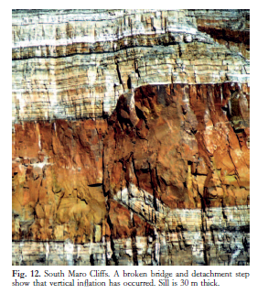
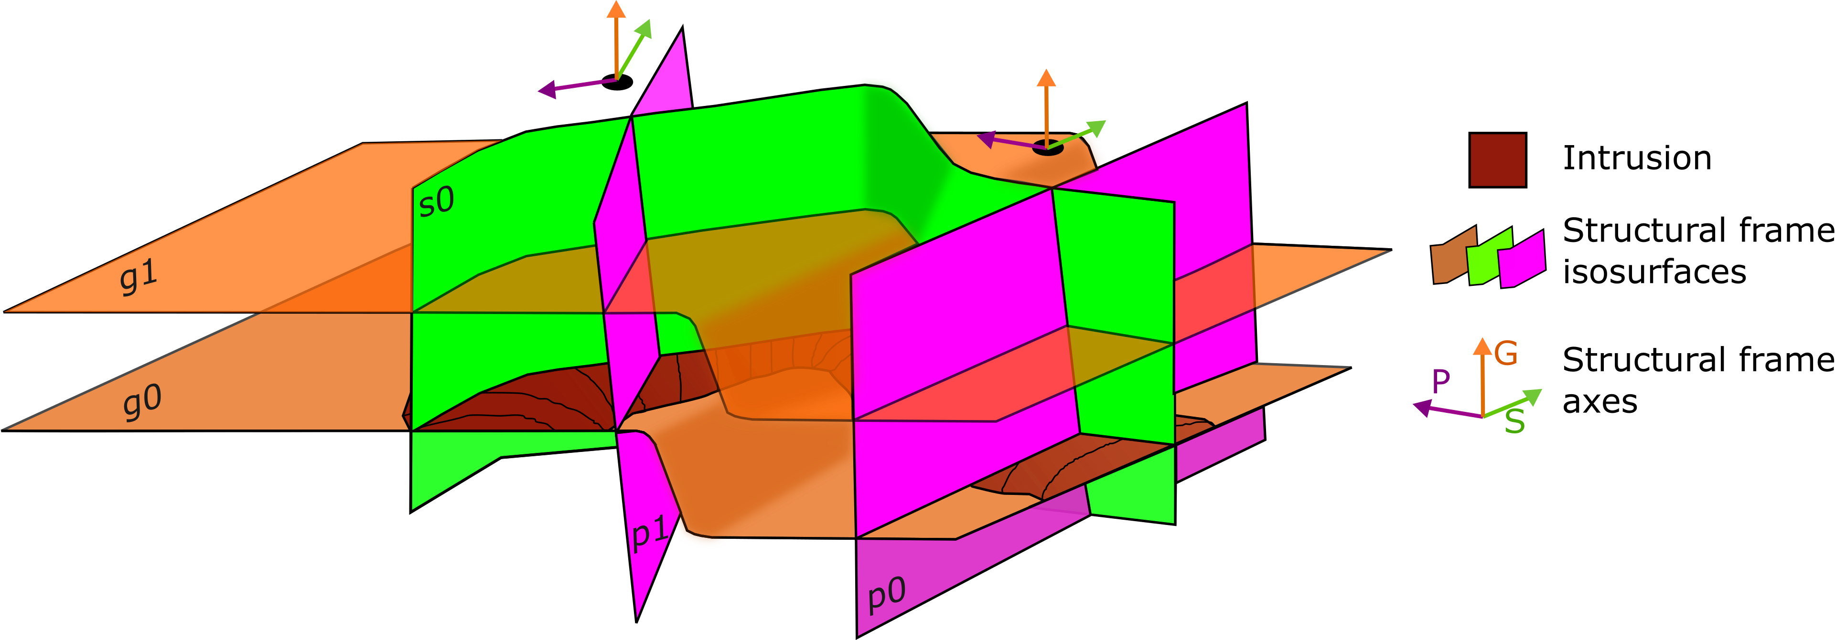
Intrusion Structural Frame
Magma flow
Step geometry, sill (Hutton, 2009)
Fernanda Alvarado-Neves (PhD candidate, Monash University

Slide 26
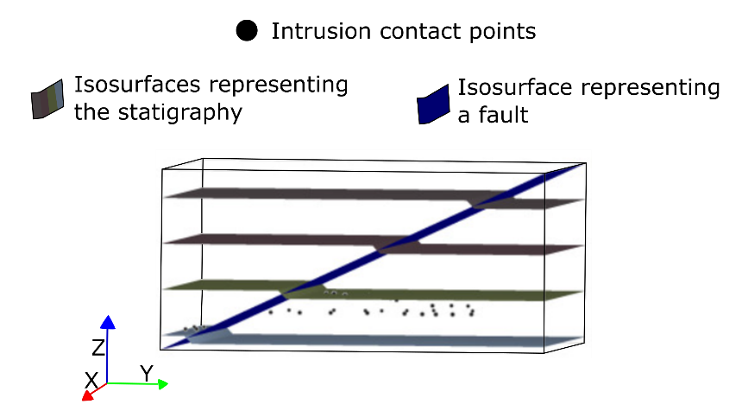
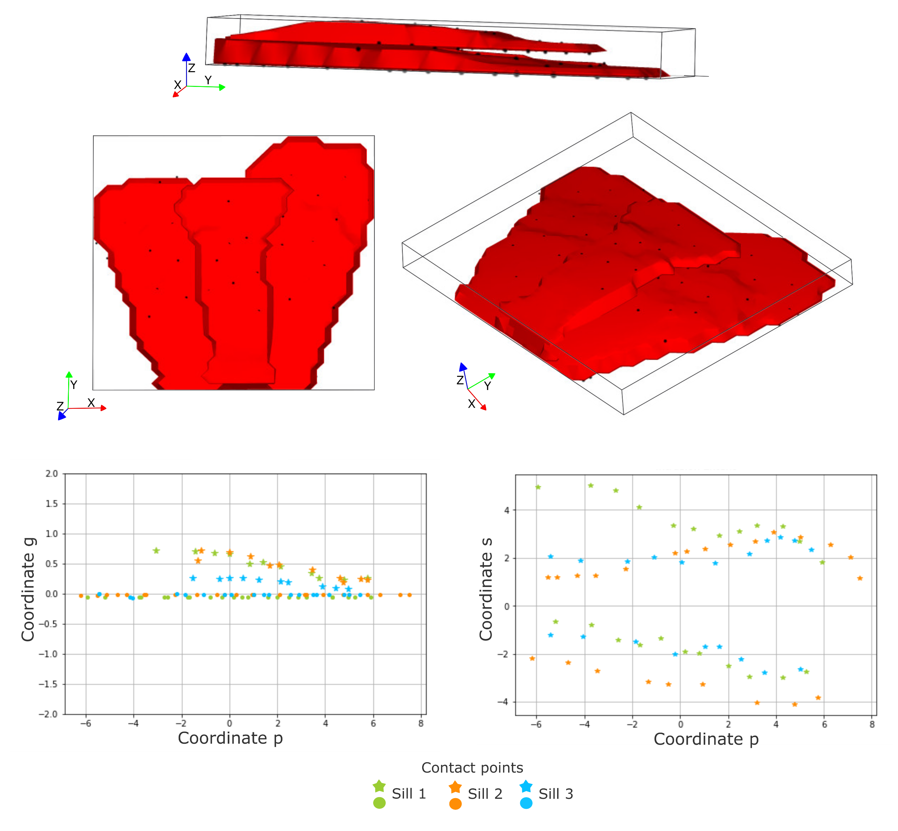
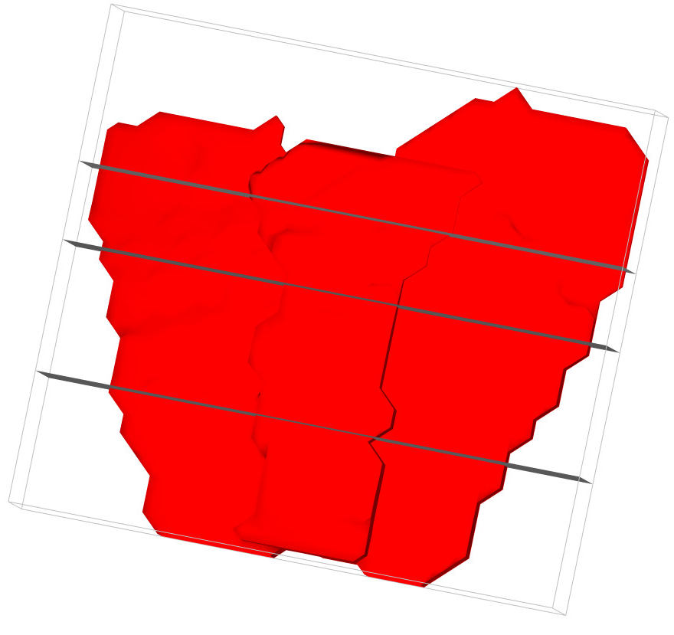
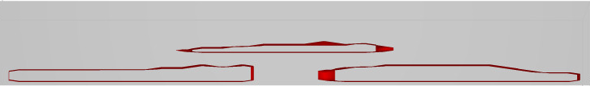
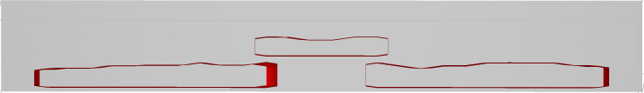

Intrusion Structural Frame
Magma flow
Fernanda Alvarado-Neves (PhD candidate, Monash University
Step geometry, sill (Hutton, 2009)

Slide 27


Intrusion Structural Frame
N
Fernanda Alvarado-Neves (PhD candidate, Monash University

Slide 28
Summary
Implicit modelling is approximating a signed distance function representing the “stratigraphic” distance
Can include:
Contact locations, or location within a stratigraphic series
Orientation data
Form surfaces
Fault geometry/kinematics
Fold overprinting relationships/foliations
Intrusion anisotropy
Assumes:
Constant(ish) stratigraphic thickness
Can’t use:
Lithology
Inequalities

Slide 29

LoopStructural
Core 3D modelling algorithms behind Loop
Python library for 3D geological modelling
Discrete interpolation using finite difference method and piecewise linear method
Fold interpolator (Laurent et al., 2016)
Implicit fault kinematics (Grose et al., in prep)
Open source (MIT license)
Available on PyPI and Github (pip install LoopStructrual)
Linked with map2loop for automatic model generation
Export surface meshes as vtk, obj
Preprint in Geoscientific Model Development
www.github.com/Loop3d/LoopStructural

Slide 30
Recent research
Use structural frames for characterising geometry of different geological objects
Lithologies?
Resource models?
Build lithology models
Relax/remove thickness constraints
Use only inequality constraints
Adapt mathematical techniques from geophysics/machine learning to improve data types used for implicit modelling

Slide 31
Modelling using inequalities
>
>
Constraints
Orange > brown and yellow
Brown < orange and > yellow
Yellow < orange and brown
Function should be as smooth
as possible

Slide 32

Adding inequality constraints
$L_{reg}={\left|Ax−b\right|}_{2}^{2}$ where A is the regularisation matrix from discrete implicit modelling
Minimise second derivative of the objective function
Inequality constraints $f\left(X\right)>l$
$v=f\left(X\right)$
For each iteration $v\left[i\right]=\min\left(v\left[i\right], l\right)$
$L_{lower}={\left|v−l\right|}_{2}^{2}$
Upper constraints are applied by updating v using the max(v,l)
Objective function to minimise is $L_{reg}+L_{lower}+L_{upper}$
Use stochastic gradient descent method for optimising objective function, here we will use ADAM optimiser.

Slide 33



An example

Slide 34



Another example

Slide 35
Summary
Using existing interpolation framework from LoopStructural inequalities are incorporated using fast optimisation algorithms
ADAM optimiser in optax the model can be solved in 6 seconds compared with 5 seconds for linear least squares using scipy. Negligible time increase!
Challenge to balance both regularisation and inequality constraints -> model is not satisfactory near boundary between data values
Modelling using inequality constraints focused on high data density environments e.g. mine scale models where thickness is more variable and may not be known.
Optimisation frameworks can allow for different types of constraints to be included at minimal cost.
Hillier et al 2022 have used a similar approach but have represented the implicit function using a neural network

